Slide 1
INTRANET REFRESH pROJECT
Design Review Meeting

Slide 2
Status update
On Track
Behind Schedule
Wireframes for:
Home page
Profiles
Integration with activities database
SharePoint development environment
Wireframes for:
Current events
Office locations
Community
Department

Slide 3
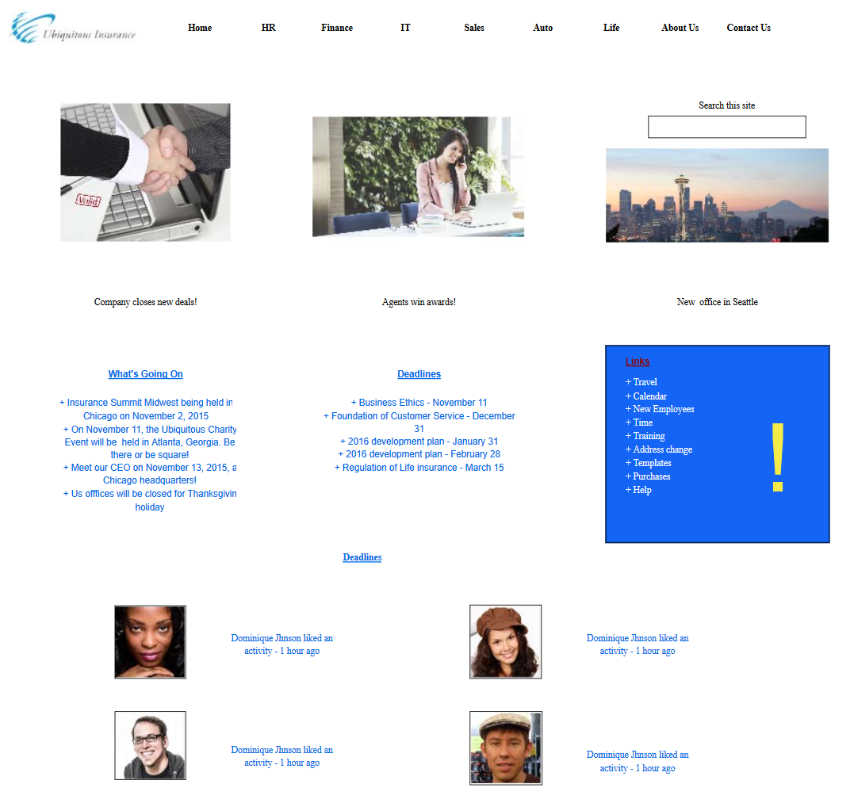
WIREFRAMES FOR HOME PAGE
Notes:
https://app.moqups.com/GRX5WF1VYx/edit/page/ac85603da

